Slide 1

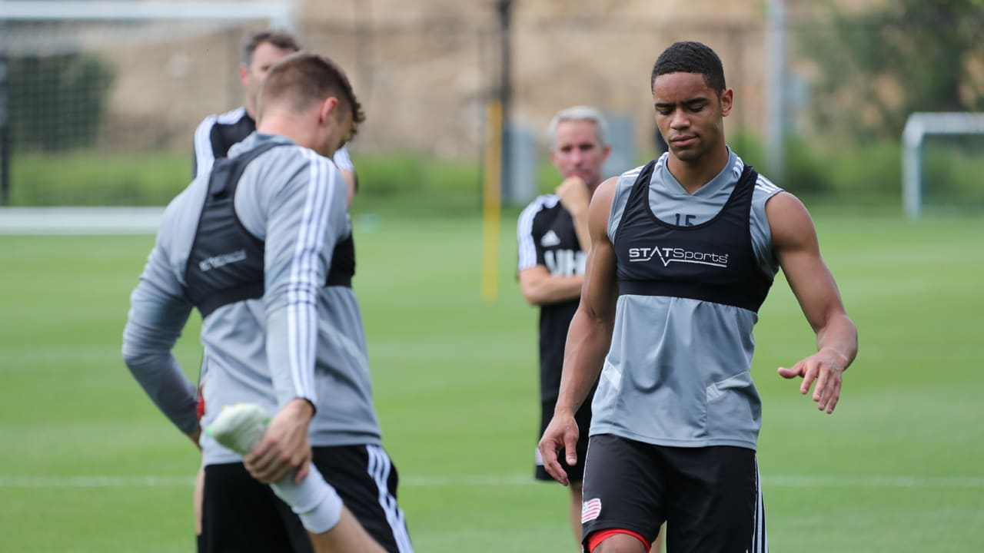
Performance Recommendation System For Soccer Players
By Montana Merkle

Slide 2
Project Summary
Utilize AI to recommend performance improvements for players on a soccer team and how to achieve those improvements
Groups players on a team based on playing style/role
Predicts the recommended drill category that should be used to improve by that group
Presents the information to the user
Notes:
My term project utilizes AI to recommend performance improvements for soccer players and how to achieve those improvements
First it groups players on a team based on playing style/role
Next it predicts the recommended drill category that should be used by that group to improve
And then it presents the information to the user

Slide 3
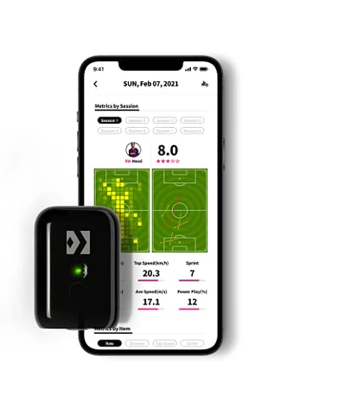
Collecting Data
This system came about due to the rising prevalence of tracking systems in soccer specifically. UNA utilizes TITAN trackers
Trackers are able to track a player’s performance in a variety of metrics
speed, distance, load (intensity and duration of effort), sprint count, active time, and more
Notes:
I had the idea for this project due to the rising prevalence of tracking system in soccer. Throughout my career as a soccer player I have used different systems on multiple occasions and here at UNA, where they use the TITAN system.
Trackers are beneficial because they are able to track player performance in a variety of metrics like speed, distance, load, and more. My project allows the data collected from trackers to be used more effectively and hopefully result in an increase in individual and team performance.

Slide 4
Project Details
Groups players on a team based on playing style/role
Use clustering on data collected from TITAN data of the current UNA season
Predicts the recommended drill category that should be used to improve by that group
Use a random forest classifier trained on labeled TITAN data from the 2023 UNA season to predict which drill category to suggest for each group
Presents the information to the user
Create graphical user interface (GUI) that is able to take in TITAN data and give the recommended drill category and exercises in the category
Notes:
Here's a more in depth breakdown of my system
To group players, clustering is conducted on game data collected from TITAN of the current UNA season using the k means algorithm
Then it utilizes a random forest classifier trained on labeled TITAN game data from last season to predict which drill category to suggest for each group
And lastly a GUI is created that is able to take in TITAN data and present the groupings and recommended drill category and description to the user

Slide 5
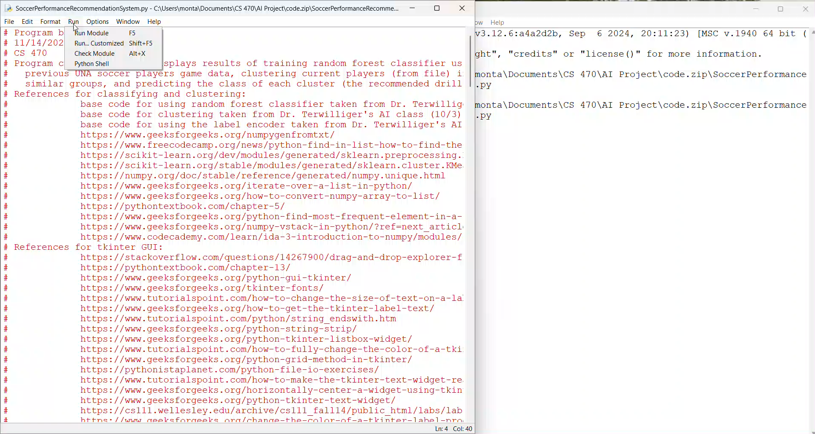

Slide 6
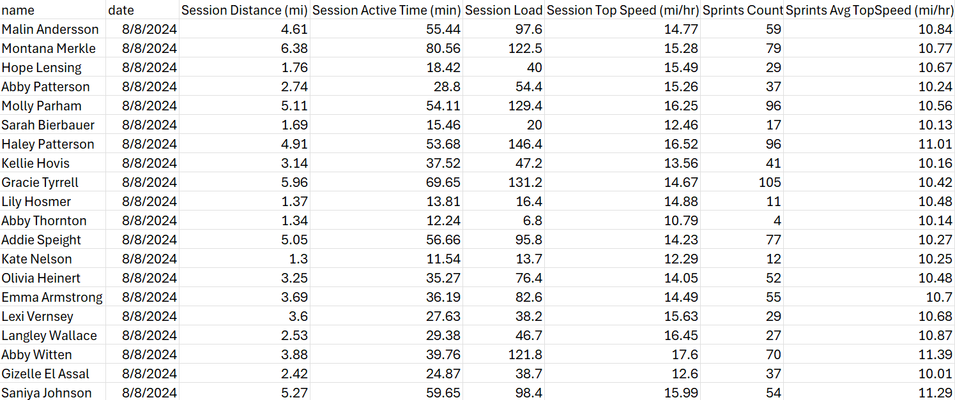
User-Provided Dataset
Notes:
This would be the data set that users would export from their tracking system. This file specifically, used in the demonstration, contains game data from the current UNA season.

Slide 7
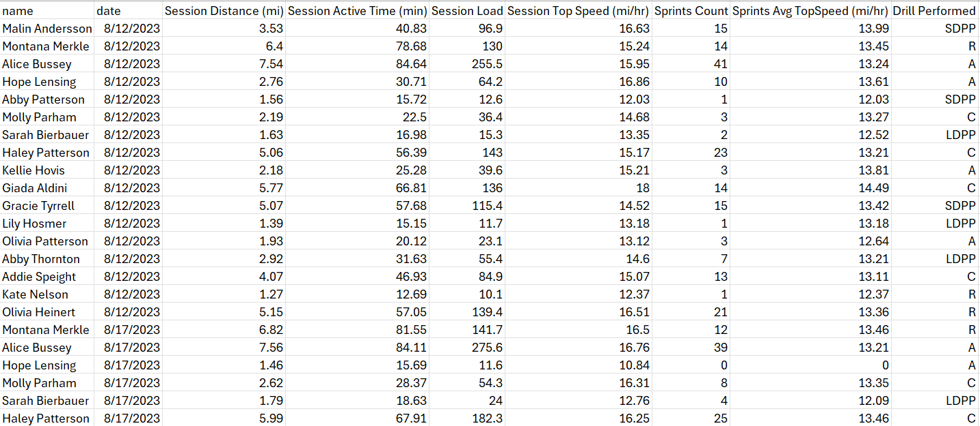
Labeled Training Dataset
Notes:
This file is the labeled training dataset taken from the 2023 UNA soccer season of previous players.
This dataset only includes data from games. Through a questionnaire, I gathered the drill category that increased the performance of each player and labeled all entries of that player in the dataset with that abbreviation. This was then used to train the random forest classifier.

Slide 8
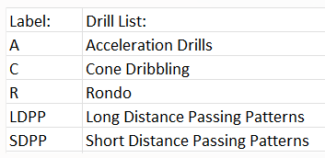
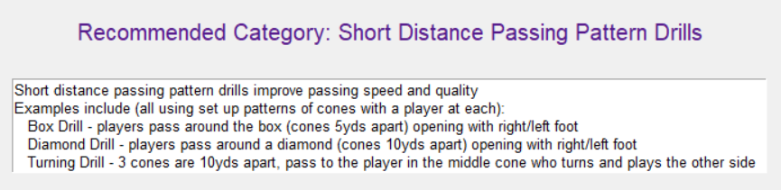
Categories of Drills
Notes:
Here is a breakdown of the abbreviated categories of drills utilized by the program; drill categories include acceleration drills, cone dribbling, rondo, long distance passing patterns, and short distance passing patterns.
After the random forest classifier is trained using the labeled dataset in the past slide, the average metrics of all players in each cluster is calculated and used to predict the recommended drill category for the cluster. Then the description of the drill category is displayed on the GUI.

Slide 9
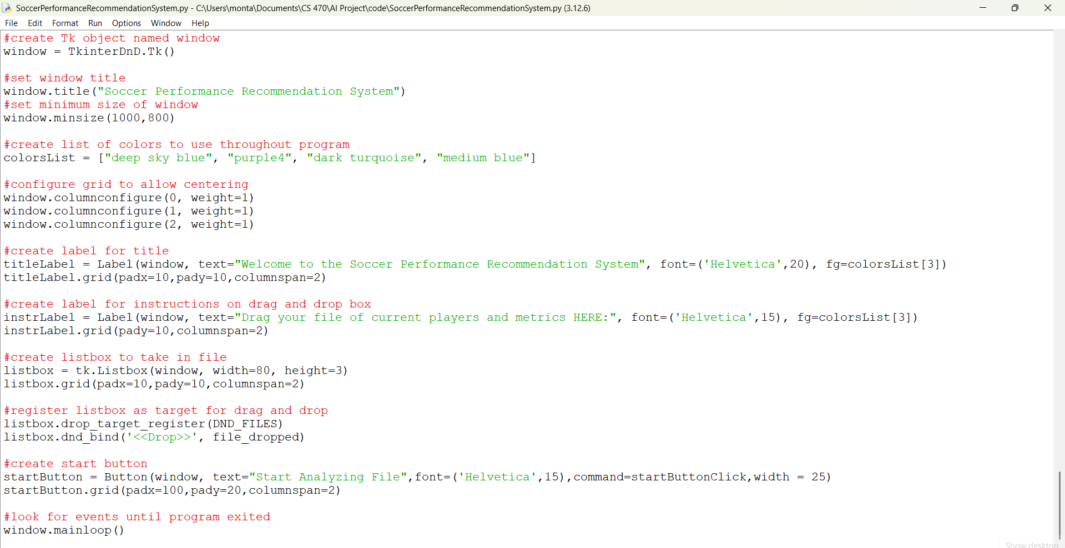
Notes:
So a brief peek under the hood of the system, this section sets up the GUI with a title, file drag-and-drop input, and a button to start analysis. Once a file is dropped into the listbox provided, the file_dropped function is called.

Slide 10
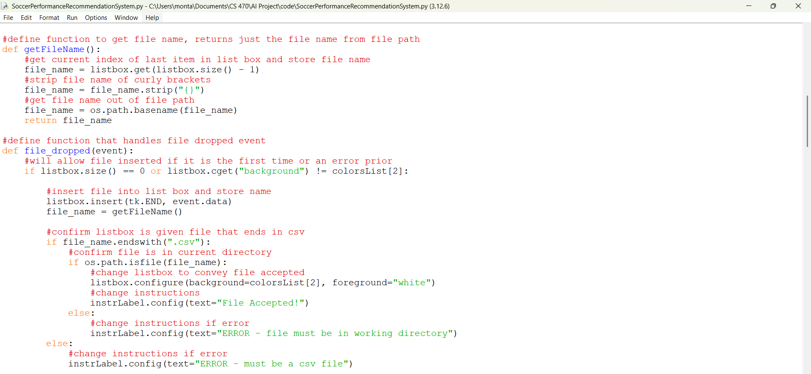
Notes:
This section defines functions to handle file input. The getFileName function extracts the file name from the file path
And the file_dropped function verified that the file provided is a CSV files in the working directory and configures the listbox background to be a color when verified.

Slide 11
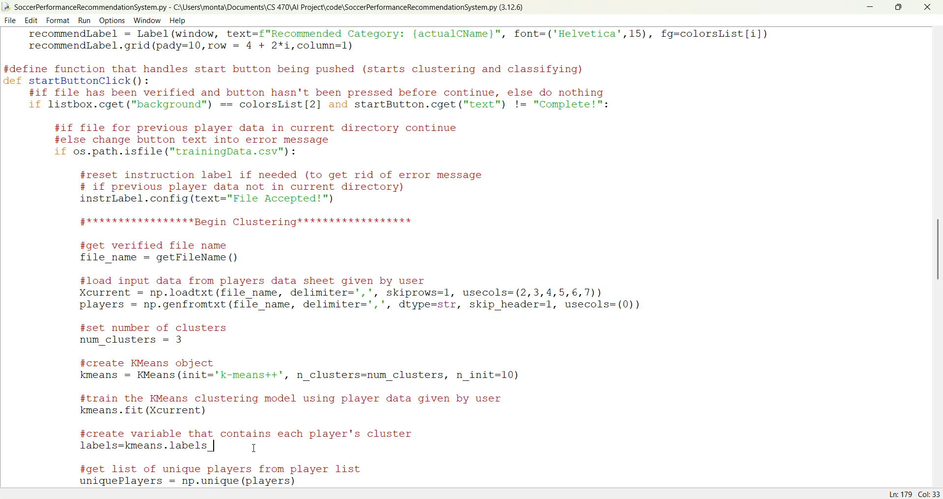
Notes:
This section defines the startButtonClick function, which begins when the start button is clicked, the listbox background is a color (thus the file verified), and the function hasn’t run before.
It organizes players into clusters based on their metrics, calculates the cluster averages, and then uses a Random Forest classifier to recommend drill categories for each cluster, updating the GUI with the results.

Slide 12
What I Did and Didn’t Do
I did not write this code from scratch.
Utilized clustering program taken from class (10/3) as a base for the clustering phase of the project
Provided the code to load input data and to train and create a Kmeans object
Utilized classifying program taken from class (9/17) and encoder program as a base for the classifying phase of the project
Provided the code to use the label encoder (to convert the drill categories to numbers for the classifier to work) and to set up the classifier and evaluate its performance
Utilized lots of online sources for the GUI development phase of the project
Provided the code to create widgets, configure text and colors, and add the drag-and-drop file functionality
Notes:
I did not write the code for this project from scratch.
I utilized the clustering, classifying, and label encoder programs provided in class as the base of my project.
For the GUI development phase of the project I had no prior experience using the Python’s tkinter library, so I utilized many websites to create the skeleton of the GUI and the drag-and-drop file functionality seen in the demonstration.

Slide 13
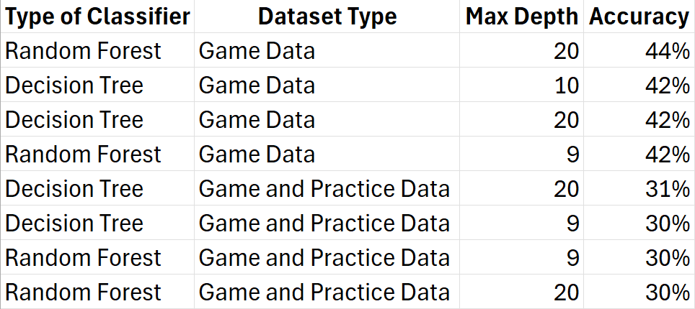
Challenges & Areas of Improvement
Struggled with the accuracy of the classifier responsible for predicting the drill categories for each cluster
Attempted to increase performance by including practice and game data for the previous players labeled dataset
Notes:
One aspect of this project that was a major challenge was the accuracy of the classifier responsible for predicting the drill categories for each cluster.
I tested two types of classifiers, decision tree and random forest, with a variety of max depths and types of datasets, one that included only game data and one with both practices and games, which actually decreased performance for both classifiers. If i were to continue this project this would be the top priority.

Slide 14
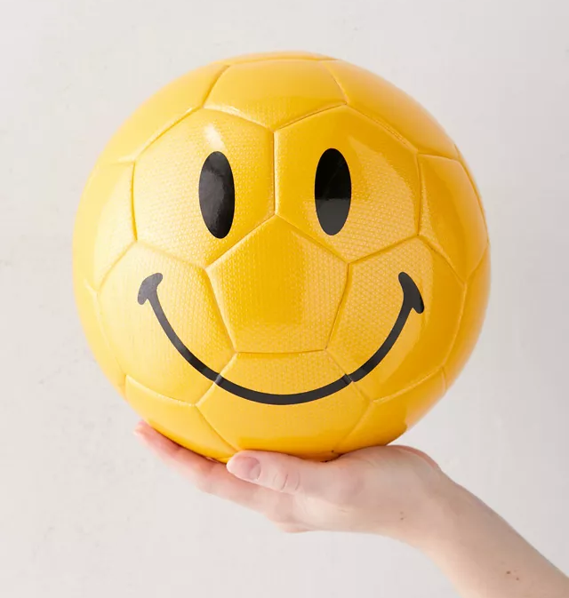
Thank You!
Notes:
Thanks!

